Slide 1
INTRODUCTION
Monitoring and controlling of substations are essential task for supplying healthy power to the consumers in this automated era. Remote monitoring and control make these substations to be operated through wireless communication technologies help of Wi-Fi communication between substation and user.
Our system aims to get real time data such as current, voltage, power factor, frequency and temperature of transformer.
The real time data is continuously monitored at ThingSpeak.
It allows the remote operator to operate relays, circuit breakers and buzzers, and facilitates the display of various parameters in the LCD that is interfaced to the microcontroller.

Slide 2
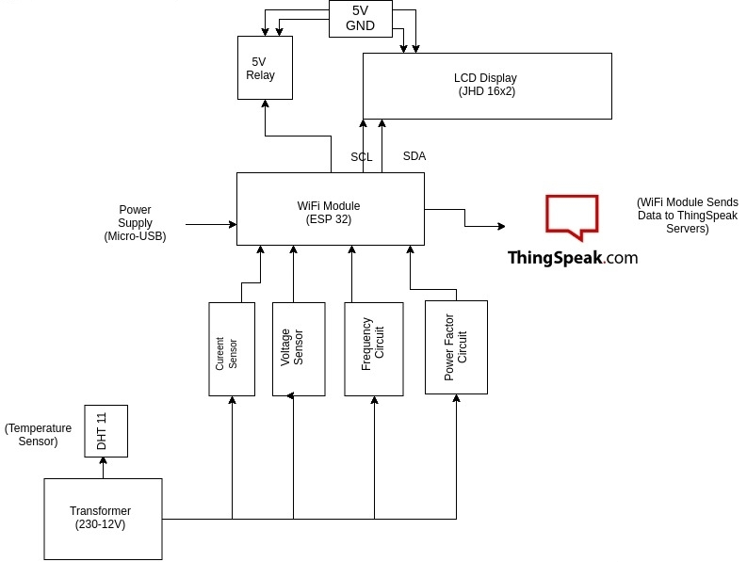

Slide 3
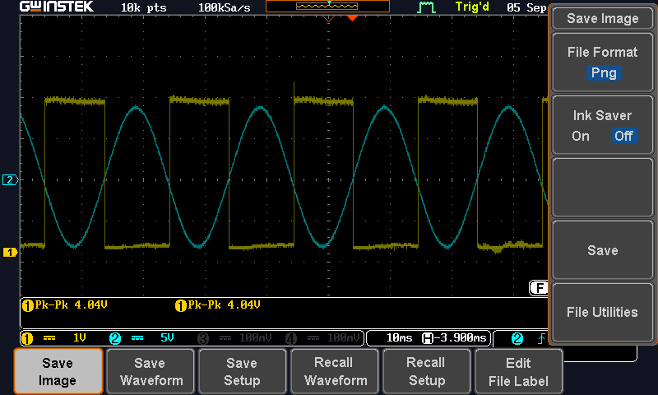
Measurement of Frequency through Schmitt Trigger, following waveform was obtained which shows that for a particular time circuit is ON and for rest of the time circuit is OFF.
On time of Circuit is measured and time is calculated, which in turn gives us Frequency of Supply.
Similarly using Schmitt trigger we can find out the value of power factor the square waveforms of current and voltage is given to XOR gate which stays on when both are not equal and gives the time.
Measurement of Frequency using Schmitt Trigger

Slide 4
Circuit Operation
The Circuit uses ESP32 as its main microcontroller which detects different parameters like Current, Voltage, Frequency, Power factor and temperature across the transformer, this data is the fed to ThingSpeak Servers and can be monitored Easily.
The Project is also integrated with BLYNK which helps remote user to control Circuit Breakers and Relays.
For Frequency Measurement Schmitt Trigger is used which converts the AC sine wave to Square wave and through arduino coding time can be measured for which Schmitt trigger is ON and through this frequency is calculated.
For Current Measurement we use ACS712 which reads AC current with the help of Hall Effect and for temperature we use DHT11.
For Power Factor measurement two Schmitt trigger and a XOR gate is used and is calculated through a formula.

Slide 5
Salient Features
The Relays and Circuit Breakers can be controlled Wirelessly with Voice Assistant using IFTTT serves.

